Slide 1
R&D Text Corpora Filtering
and Data Mining:
Case Study on Digitalization
Data Science for the Public Good
31 May 2022

Slide 2
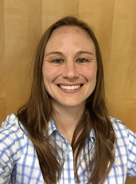
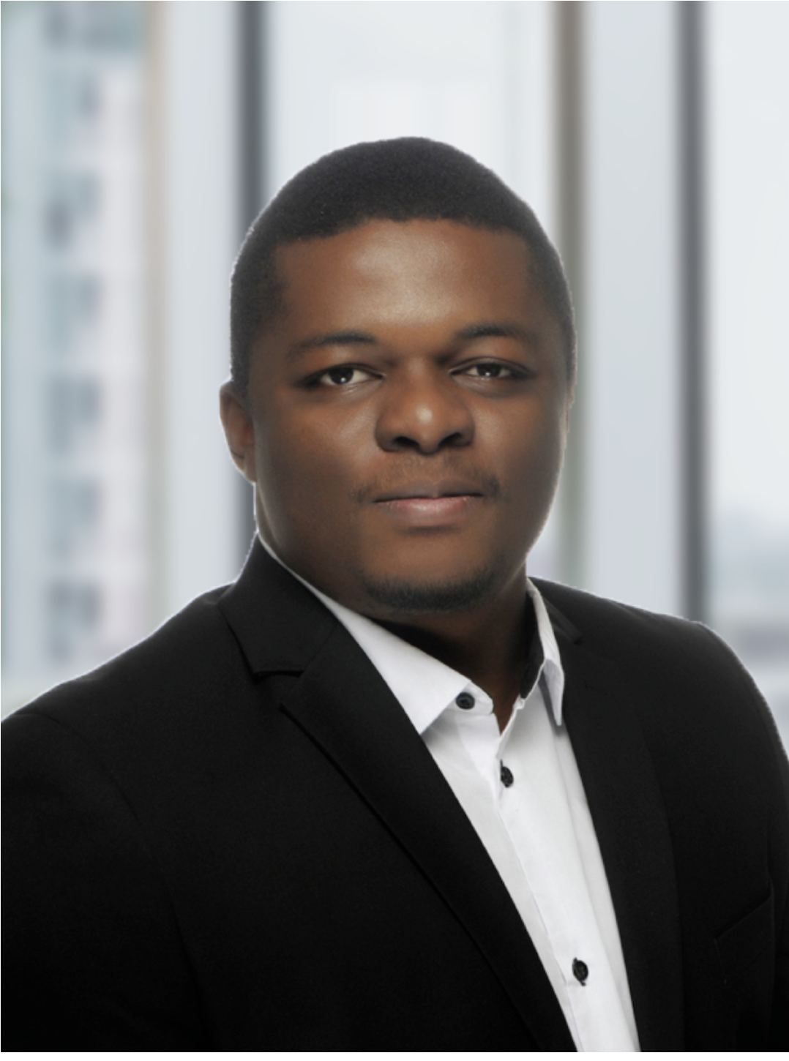

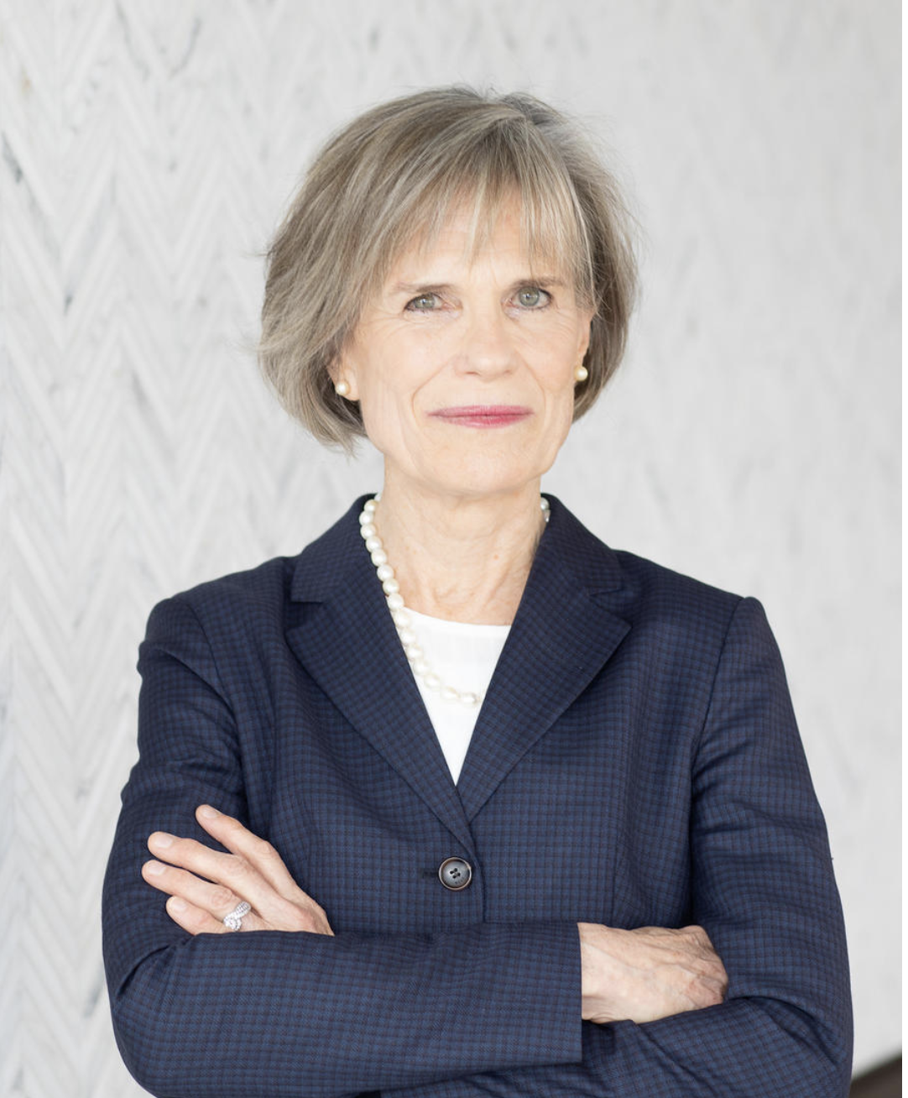

Team
SDAD:
Kathryn, applied math
Leonel, Postdoc researcher
Joel, social psychology
Stephanie, Deputy Division Director, economics
Sponsor:
The National Center for Science and Engineering Statistics (NCSES),
Research & Development Statistics Program
John Jankowski, Program Director
Audrey Kindlon, Survey Statistician

Slide 3
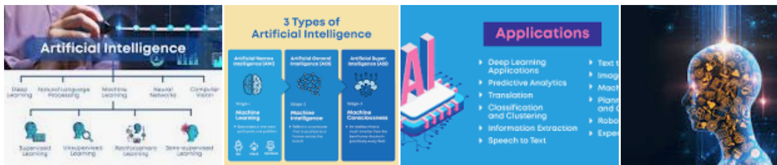
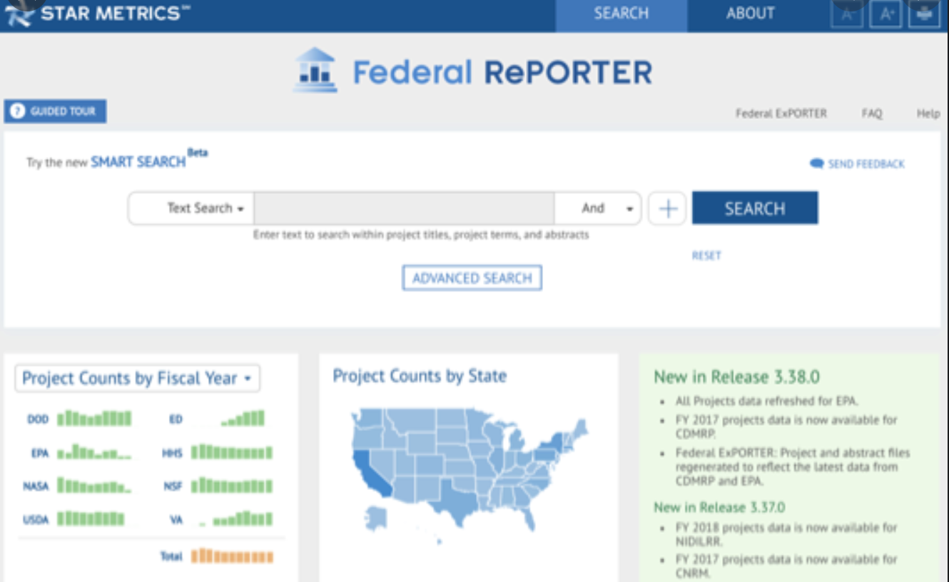
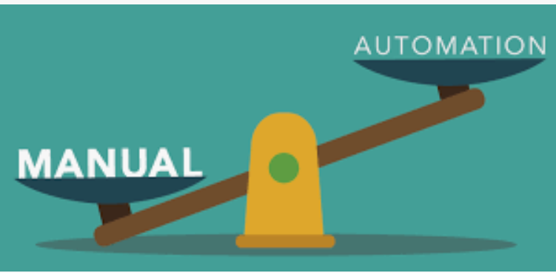
Project Introduction
Data Source: Grant abstracts contained in Federal RePORTER, 2008-2019
We already have a cleaned dataset
~700,000 abstracts
RQ: How can we characterize the R&D digitalization research area that the funding supported? What are trends in the digitalization research area?
RQ: What are the emerging topics in the area of digitalization within Federal RePORTER?

Slide 4
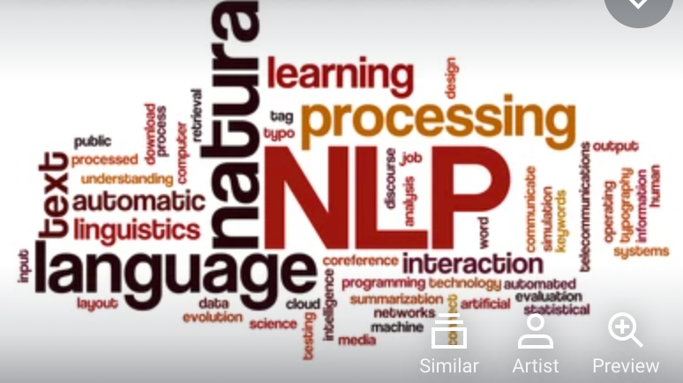
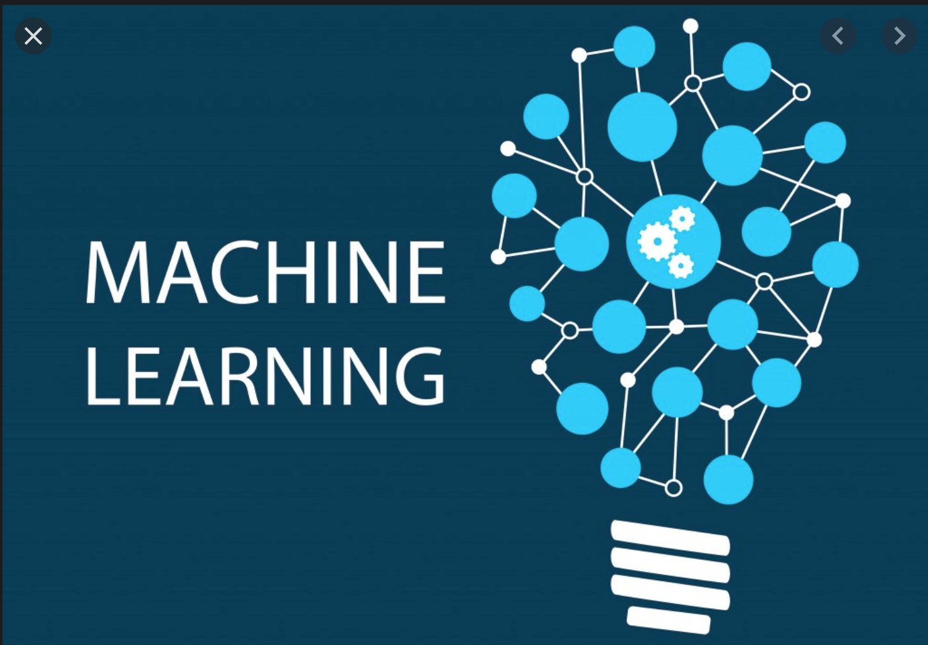
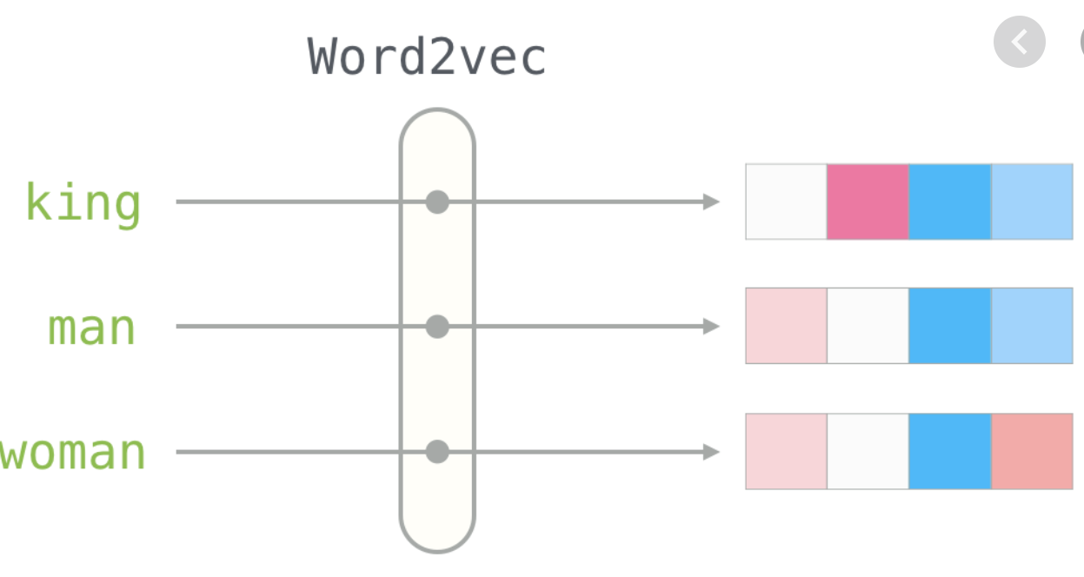
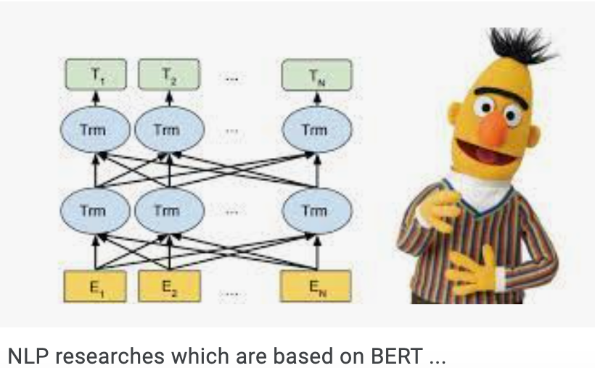
Technical Areas
Natural Language Processing (NLP)
Machine Learning
Topic Modeling: unsupervised machine learning methods to discover themes in text
Information Retrieval: the process of finding documents related to a concept in a corpus
Embeddings: Word2Vec, Sentence2Vec, BERT

Slide 5
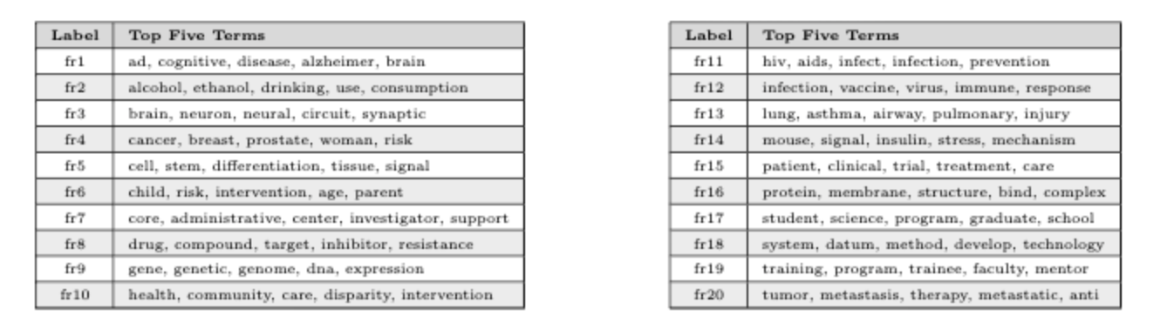
Prior Work – Topic Modeling
Data: Federal RePORTER grant abstracts
Methods:
Topic Modeling (Latent Dirichlet allocation, non-negative matrix factorization)
Software: Python
Focus: Pandemics, Artificial Intelligence

Slide 6
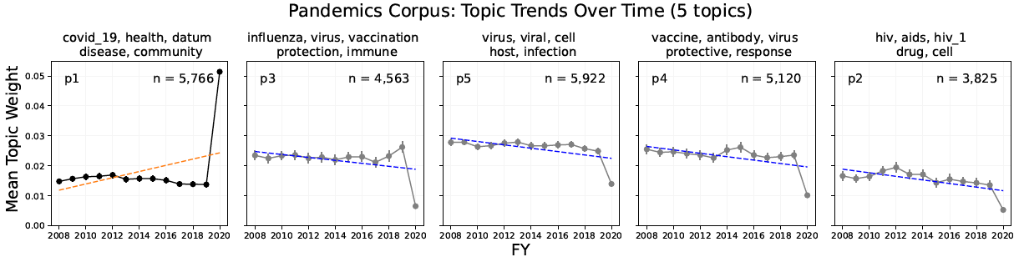
Prior Work - Pandemics
Data: Federal RePORTER grant abstracts
Methods:
Topic Modeling (Latent Dirichlet allocation, non-negative matrix factorization)
Term-Matching
Latent Semantic Indexing

Slide 7
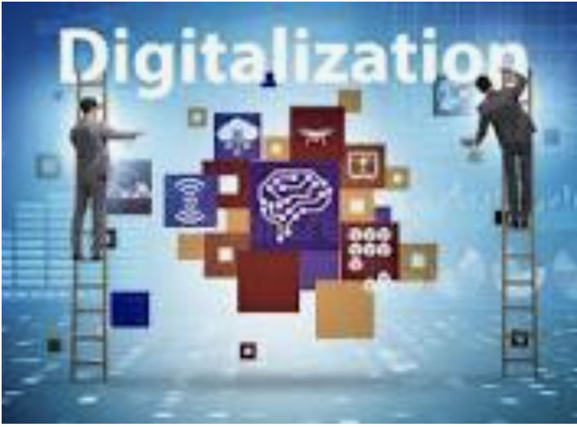
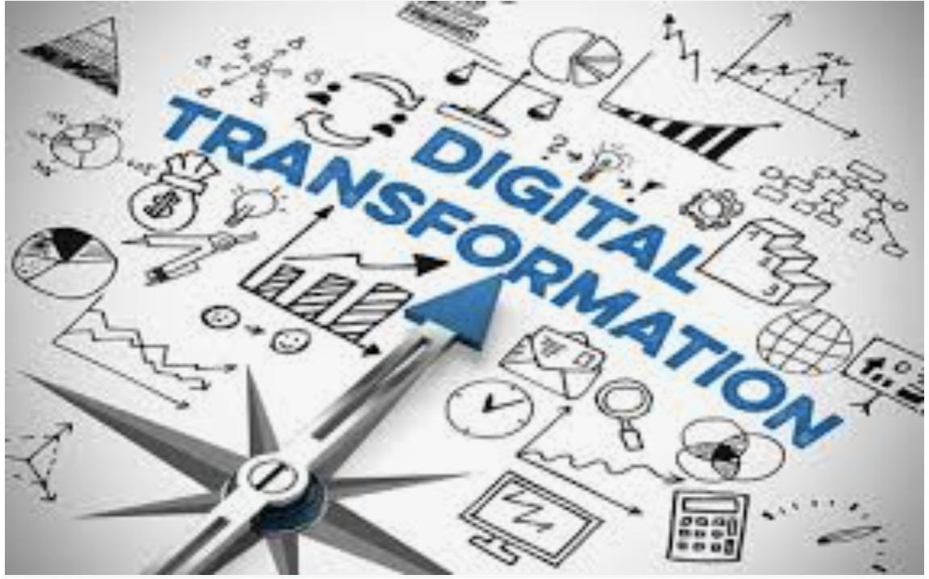
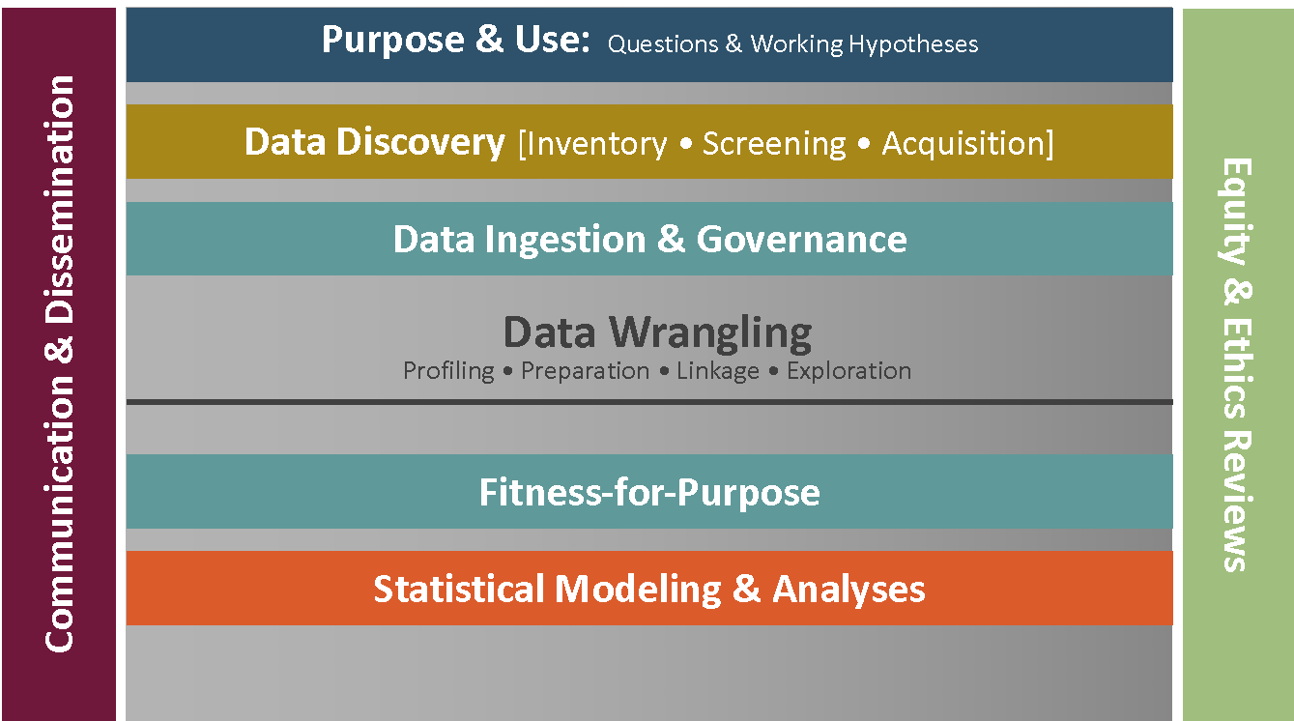
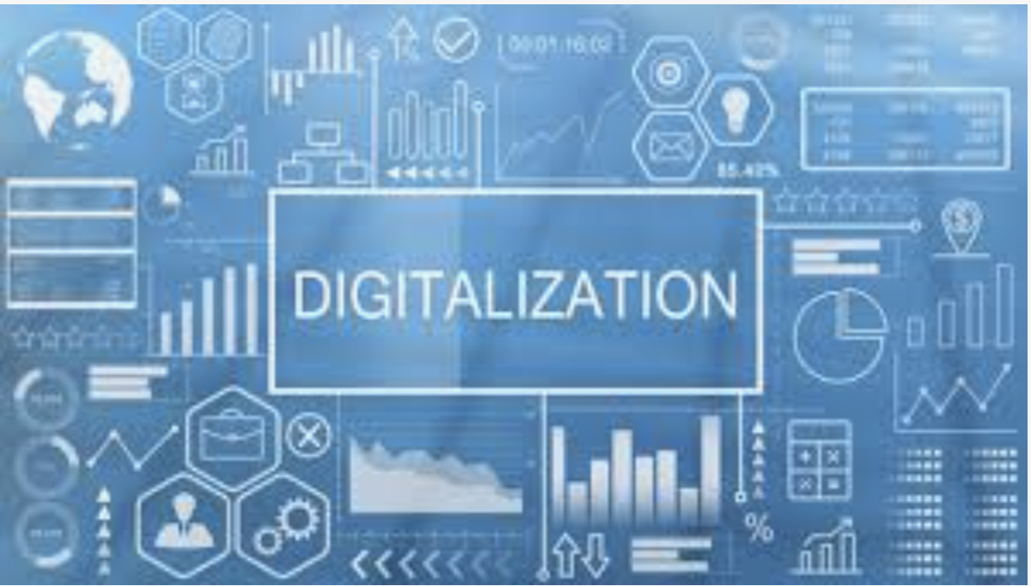
How can we improve and extend results?
Explore digitalization topics and trends in federally funded grant (includes digital innovation and technologies, emerging technologies, and particular interests in AI, cybersecurity and deep tech).
Define digitalization (literature review, talk to experts)
Identify abstracts, discover topics, conduct trends analysis.
Our data science framework: defining purpose and use, discovering data sources, wrangling data, exploring data, statistically analyzing data, assessing fitness-for-use, communicating and disseminating, addressing ethics and equity questions.

